Slide 1
딥러닝 이론 교육
딥러닝 활용 기술
Joonhyeon Park <junpark25@ajou.ac.kr>

Slide 2
Summary

Slide 3
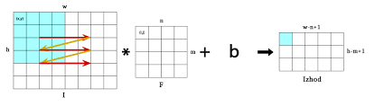
Convolution Neural Network Computation

Slide 4
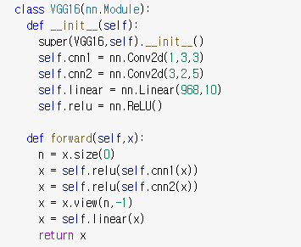
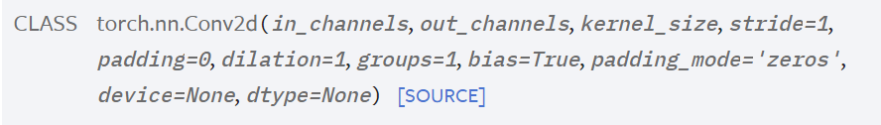
Convolution Neural Network Computation
nn.Conv2d(1,3,3)

Slide 5
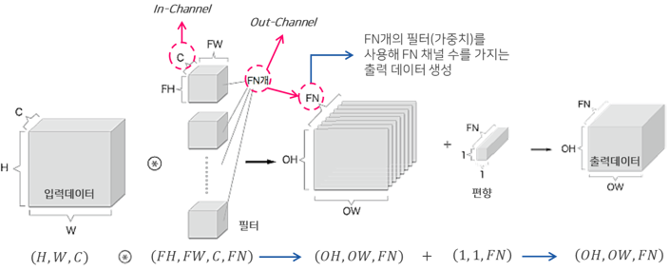
Convolution Neural Network Computation
https://excelsior-cjh.tistory.com/180

Slide 6
Convolution Neural Network
# of Parameters
Name | Input | Weight | Bias | Output
cnn1 | 22x22x1 | (3x3)x1x3 | 3 | 22x22x3
cnn2 | 22x22x3 | (5x5)x3x2 | 2 | 22x22x2
linear | 968 | 968x10 | 10 | 10

Slide 7
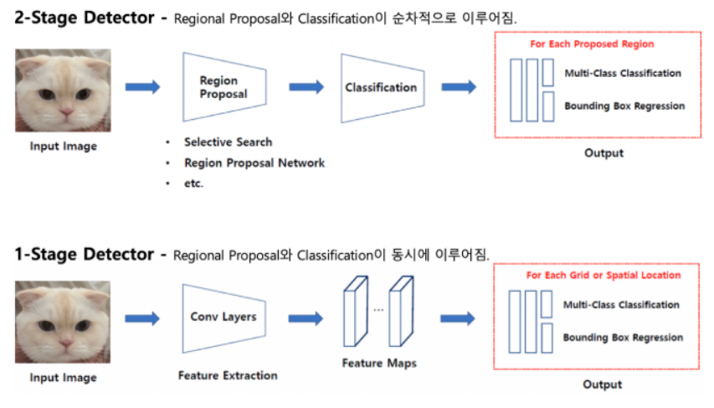
CNN Applications
Object Detection

Slide 8
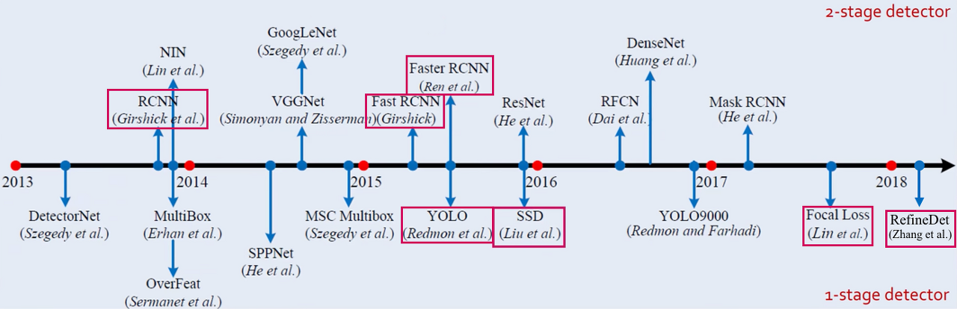
CNN Applications
Object Detection

Slide 9
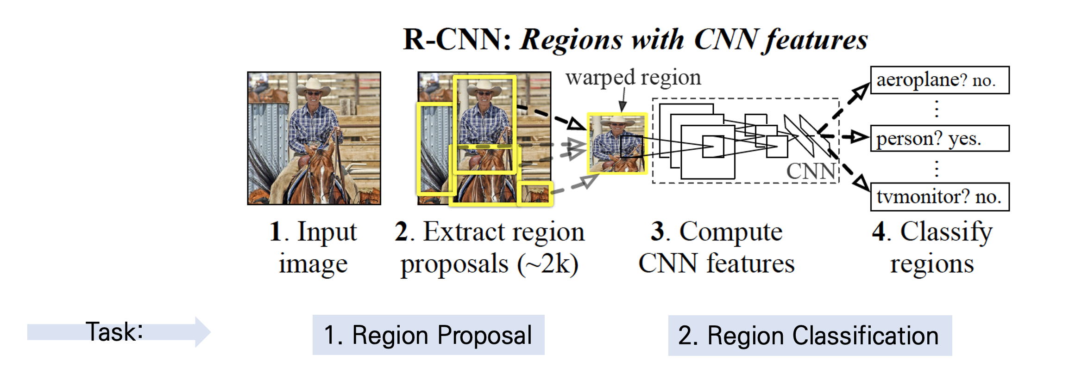
CNN Applications
Object Detection – RCNN based

Slide 10
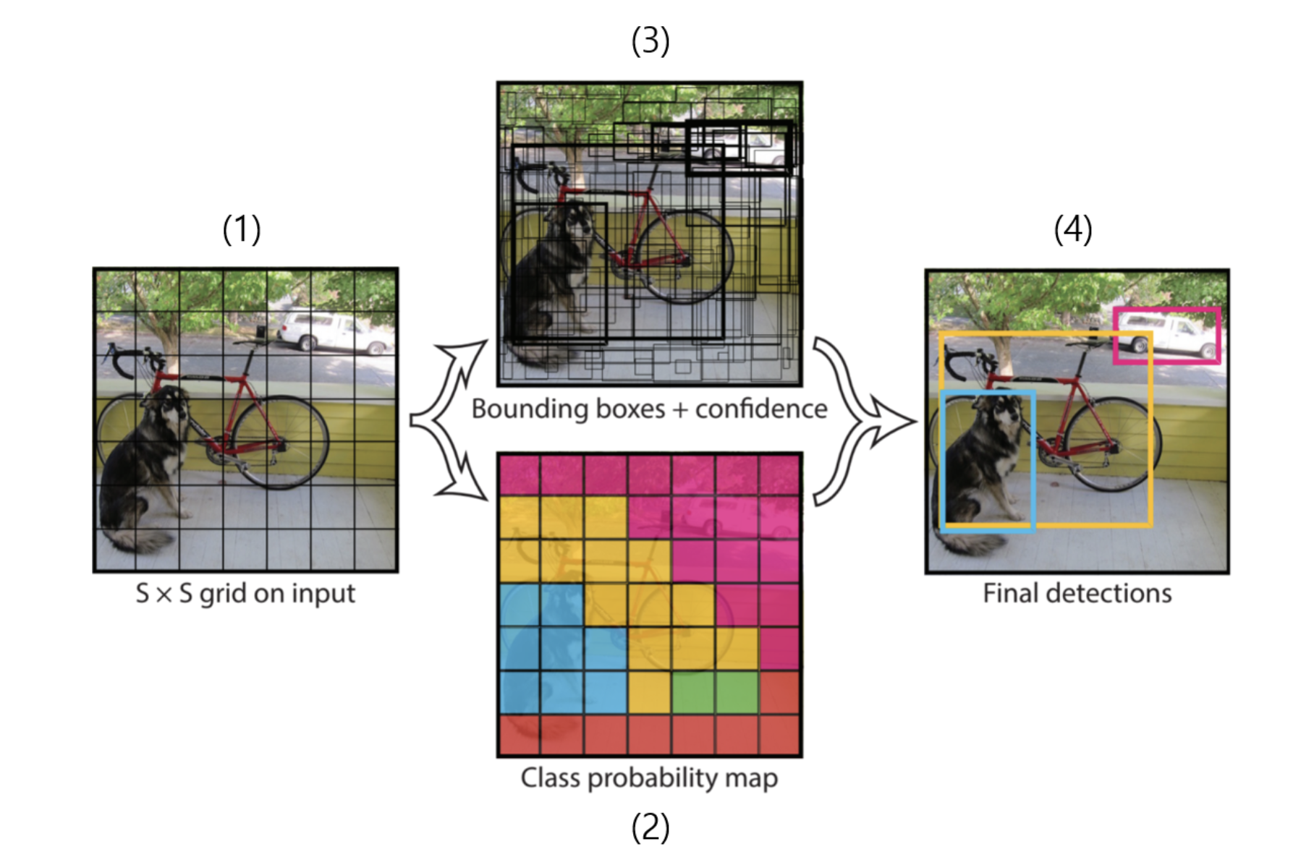
CNN Applications
Object Detection – YOLO based

Slide 11
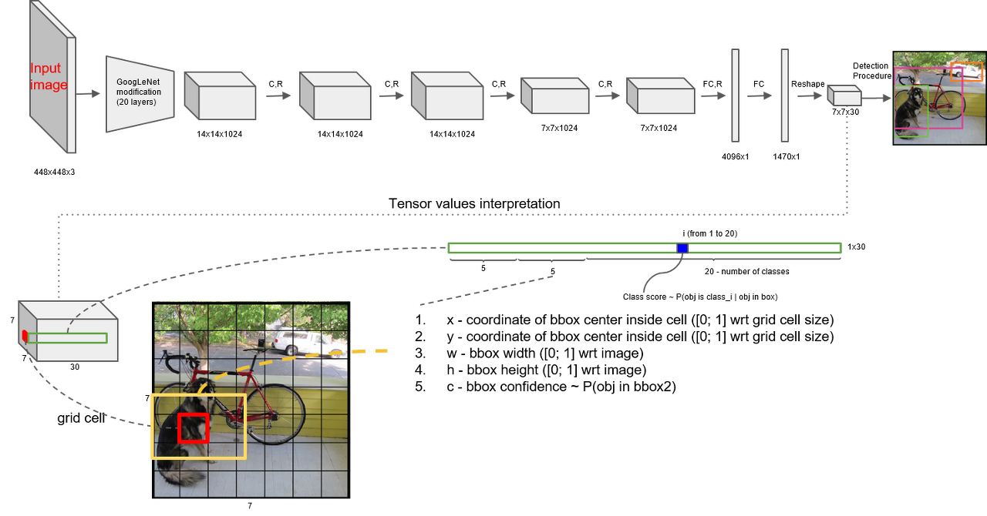
CNN Applications

Slide 12
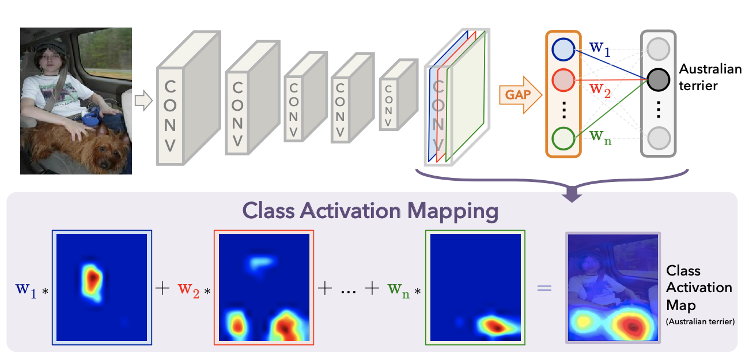
CNN Applications
Class Activation Map (2016)

Slide 13
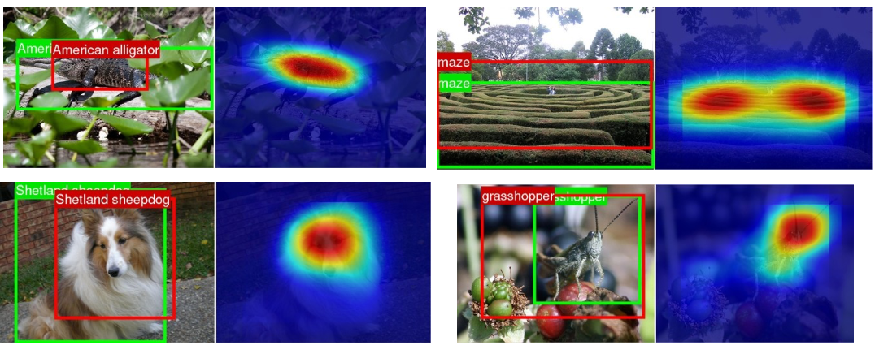
CNN Applications
Class Activation Map (2016)

Slide 14
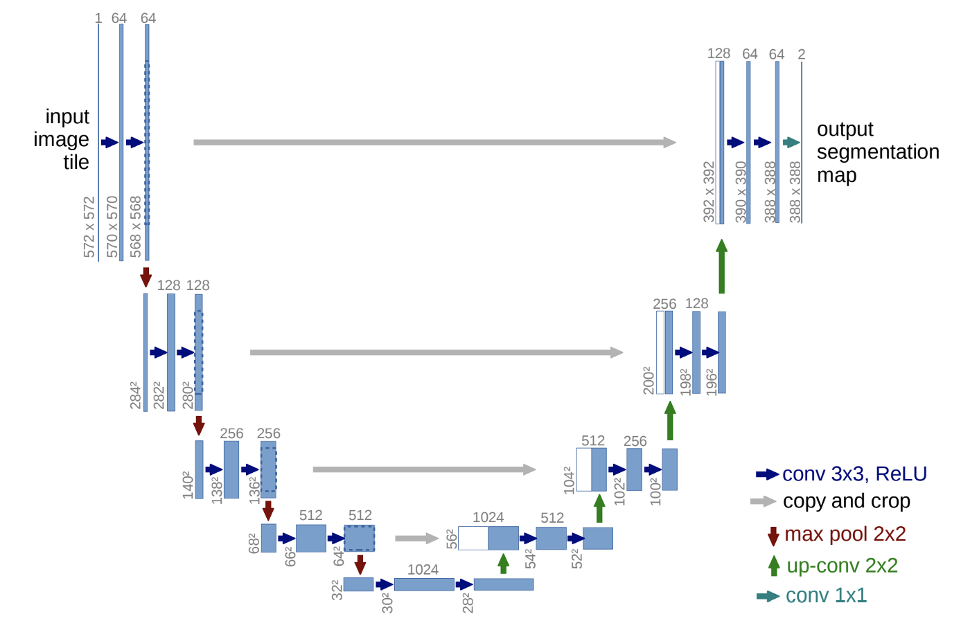
CNN Applications
U-Net (2015)

Slide 15
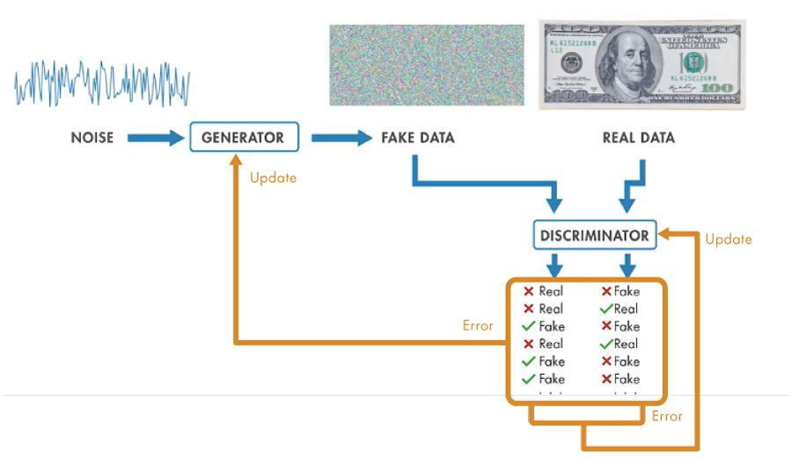
CNN Applications
GAN (2014)

Slide 16
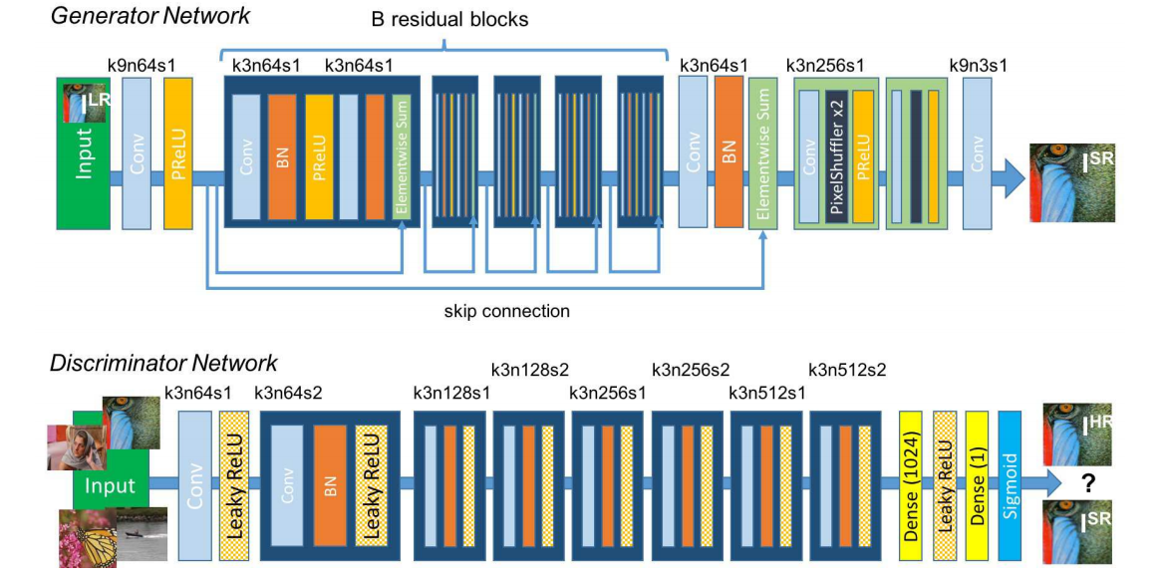
CNN Applications
SRGAN (2017)

Slide 17
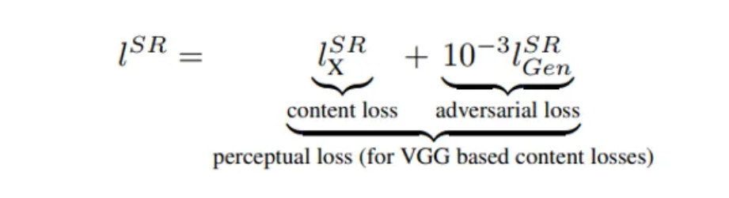
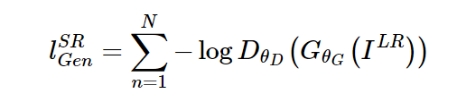
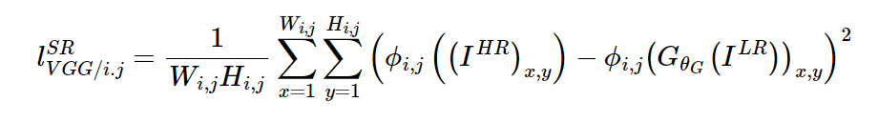
CNN Applications
SRGAN (2017)

Slide 18
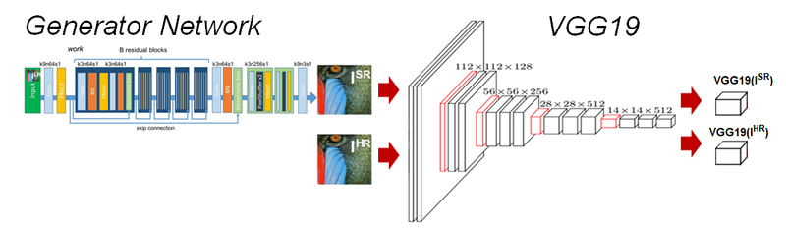
CNN Applications
SRGAN (2017)

Slide 19
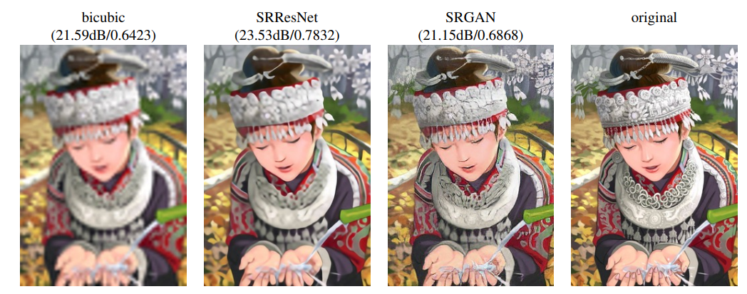
CNN Applications
SRGAN (2017)

Slide 20
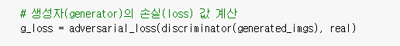
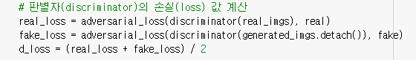
GAN
Discriminator가 만든 이미지를 진짜라고 인식하는 방향으로 Training
Generator가 만든 이미지는 가짜라고, 진짜 이미지를 진짜라고 인식하는 방향으로 Training

Slide 21
CNN Applications
GAN (2014)

Slide 22
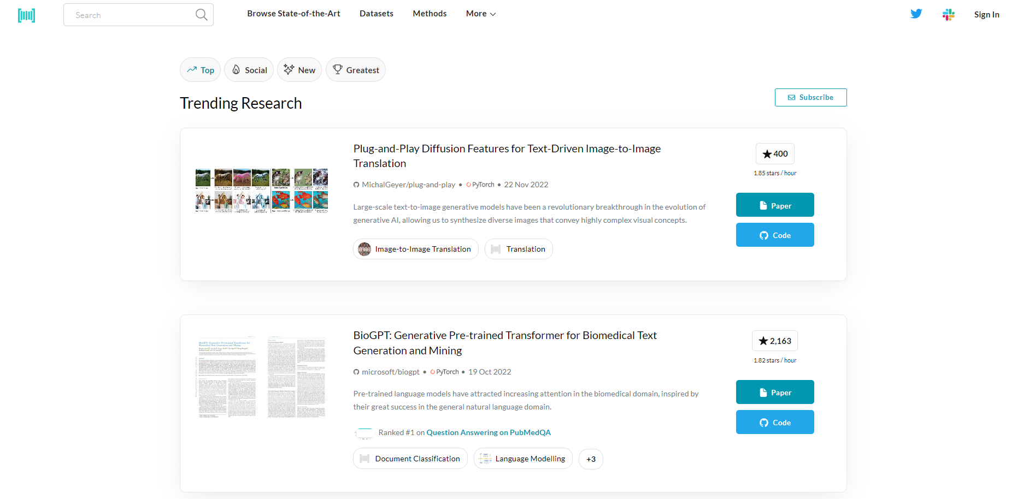
Lab 04
https://paperswithcode.com/

Slide 23
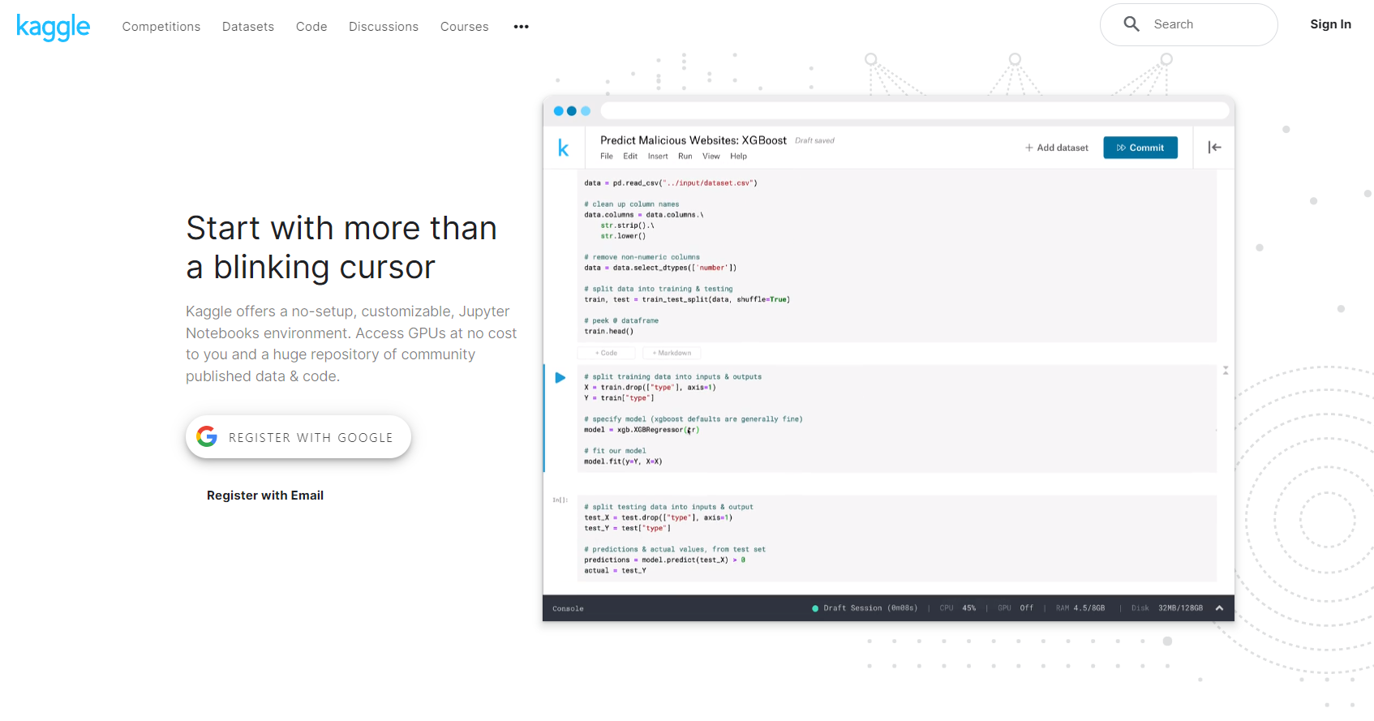
Lab 04
https://www.kaggle.com/

Slide 24
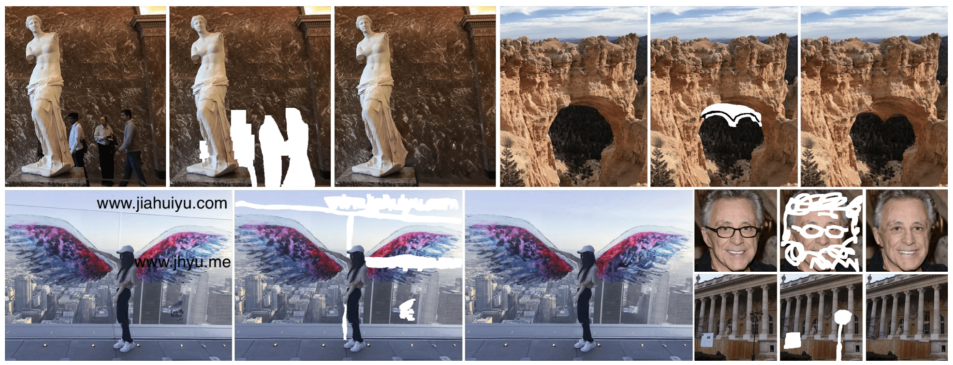
Lab 04
Object Remover

Slide 25
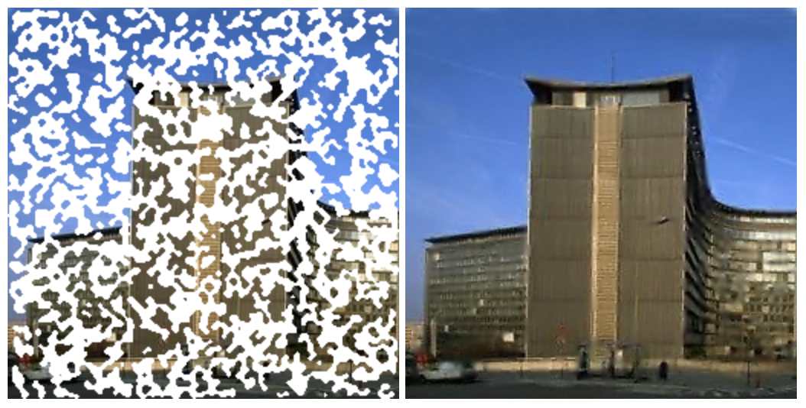
Lab 04
Image Inpainting

Slide 26
Lab 04
Research Design - Dataset

Slide 27
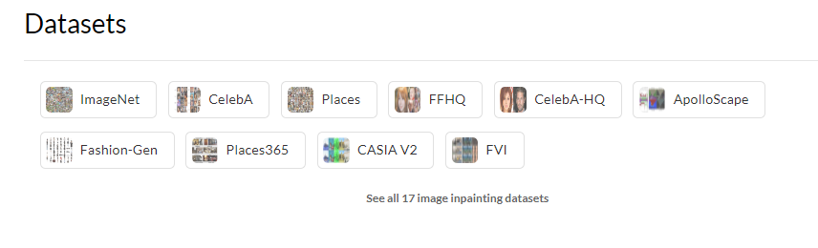
Lab 04
Research Design - Dataset

Slide 28
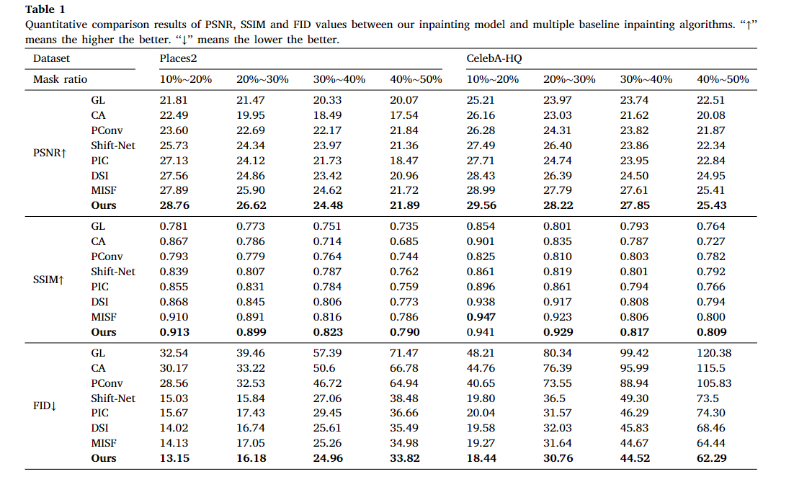
Lab 04
Evaluation Mertics
원본 이미지를 활용해 생성, Skip Connection 필수

Slide 29
Lab 04
Research Design – Network Design
원본 이미지를 활용해 생성, Skip Connection 필수
시각적 평가 우수를 원한다 -> GAN based
PSNR이 높기를 원한다 -> MSE based

